Slide 1

intive.com

Slide 2
Content
Introduction
Discriminated unions
Generics
Tuples
Recursion
Summary

Slide 3
TypeScript type system
Functional approach
Can’t mutate types
Recursive types
Tail recursion optimization

Slide 4
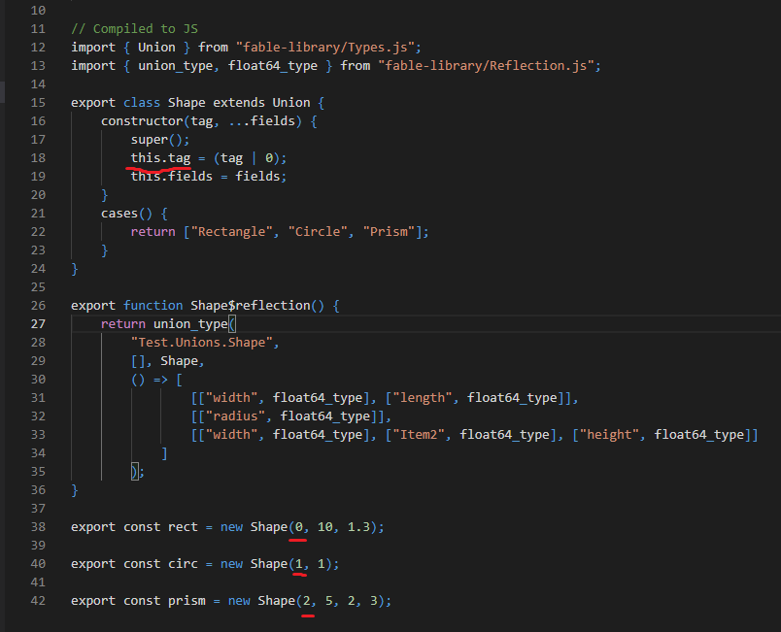
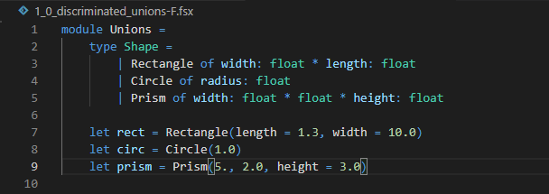
1.Discriminated unions
F# compiled to JavaScript
F# code

Slide 5
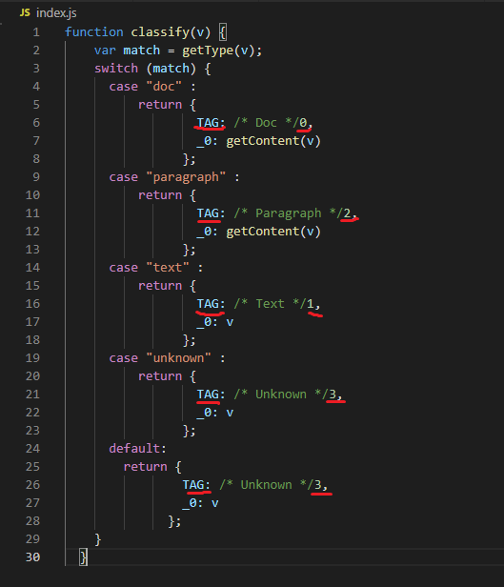
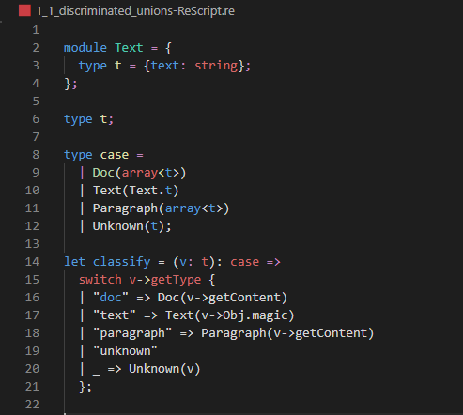
2.Discriminated unions
ReScript compiled to JavaScript
ReScript code

Slide 6
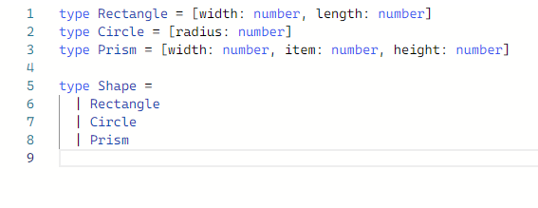
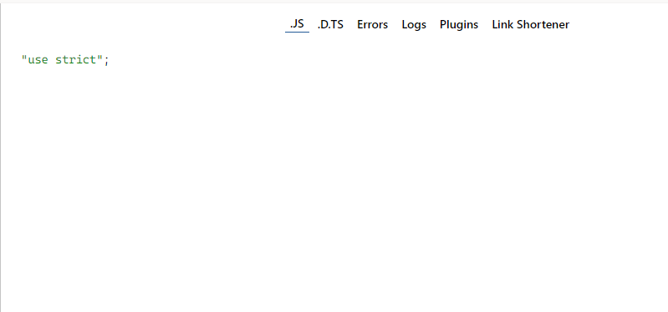
3.Discriminated unions
TypeScript compiled to JavaScript
TypeScript code

Slide 7
Code examples
IDE

Slide 8
Q&A

Slide 9
This presentation will be available on YouTube

